Slide 1

UNIVERSITY INSTITUTEOF ENGINEERING
Bachelor of Engineering (Computer Science & Engineering)
Operating System (CST-328)
Subject Coordinator: Er. Puneet kaur (E6913)
Introduction to Operating System
DISCOVER . LEARN . EMPOWER
Font size 24

Slide 2
Lecture 16 Paging & Paging Techniques

Slide 3
PAGING
Permits a program's memory to be physically noncontiguous so it can be allocated from wherever available. This avoids fragmentation and compaction.
Logical address space of a process can be noncontiguous; process is allocated physical memory whenever that memory is available and the program needs it.
Divide physical memory into fixed-sized blocks called frames (size is power of 2, between 512 bytes and 8192 bytes).
Divide logical memory into blocks of same size called pages.
Keep track of all free frames.
To run a program of size n pages, need to find n free frames and load program.
Set up a page table to translate logical to physical addresses.
Internal fragmentation.

Slide 4
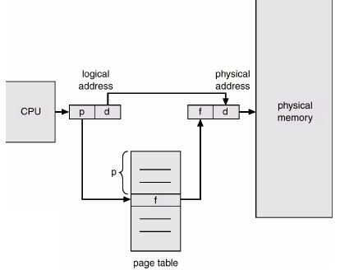
PAGING
An address is determined by:
page number ( index into table ) + offset
---> mapping into --->
base address ( from table ) + offset.

Slide 5

PAGING
Address generated by the CPU is divided into:
• Page number (p) – used as an index into a page table which contains base address of each page in physical memory.
• Page offset (d) – combined with base address to define the physical memory address that is sent to the memory unit.
For given logical address space 2^{m} and page size 2^{n}
Address Translation Scheme
Logical Address = Page number + page offset
Physical Address = Frame number + page offset

Slide 6
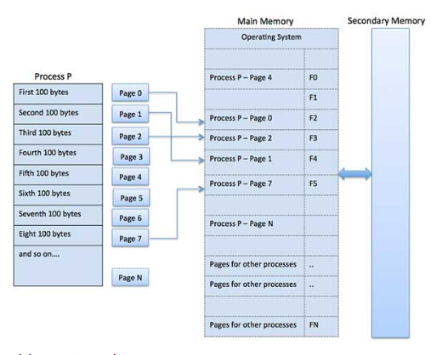
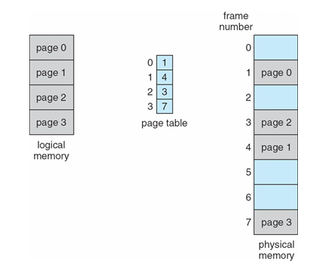
PAGING

Slide 7
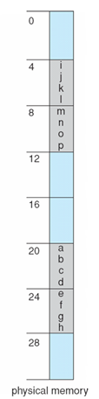
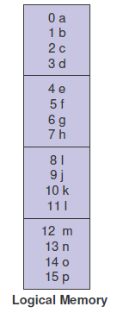
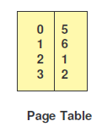
PAGING Example
32-byte memory with 4-byte pages

Slide 8
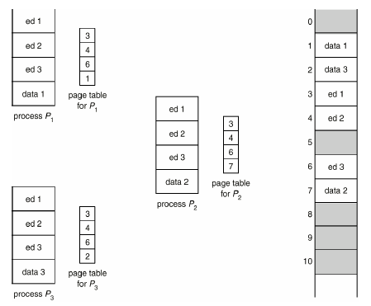
SHARED PAGES
SHARED PAGES
Data occupying one physical page, but pointed to by multiple logical pages.
Useful for common code -must be write protected. (NO write-able data
mixed with code.)
Extremely useful for read/write communication between processes.

Slide 9
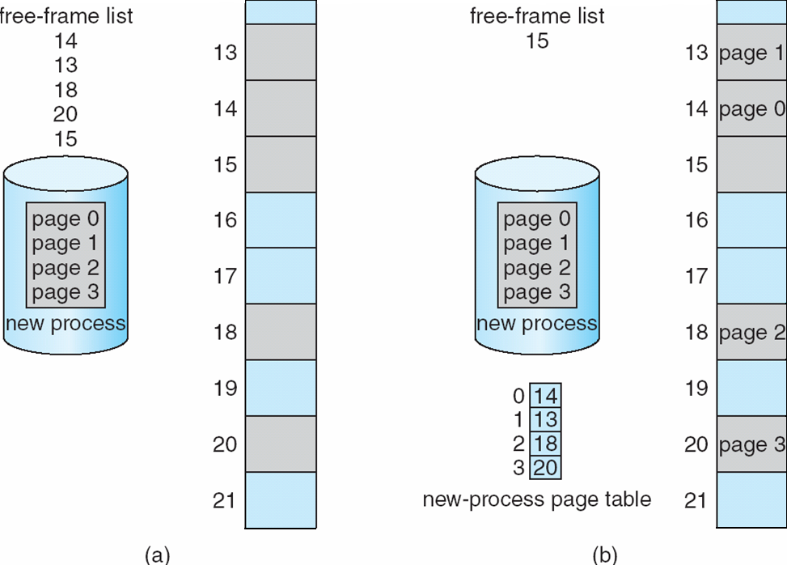
Free Frames
Before allocation
After allocation

Slide 10
PAGING
Calculating internal fragmentation
Page size = 2,048 bytes
Process size = 72,766 bytes
35 pages + 1,086 bytes
Internal fragmentation of 2,048 - 1,086 = 962 bytes
Worst case fragmentation = 1 frame – 1 byte
On average fragmentation = 1 / 2 frame size
So small frame sizes desirable?
But each page table entry takes memory to track
Page sizes growing over time
Solaris supports two page sizes – 8 KB and 4 MB
Process view and physical memory now very different
By implementation process can only access its own memory

Slide 11
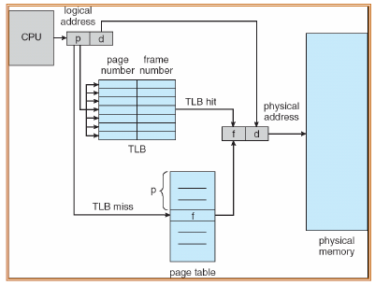
Implementation of Page Table
Page table is kept in main memory
Page-table base register (PTBR) points to the page table
Page-table length register (PTLR) indicates size of the page table
In this scheme every data/instruction access requires two memory accesses
One for the page table and one for the data / instruction
The two memory access problem can be solved by the use of a special fast-lookup hardware cache called associative memory or translation look-aside buffers (TLBs)

Slide 12
Implementation of Page Table
Some TLBs store address-space identifiers (ASIDs) in each TLB entry – uniquely identifies each process to provide address-space protection for that process
Otherwise need to flush at every context switch
TLBs typically small (64 to 1,024 entries)
On a TLB miss, value is loaded into the TLB for faster access next time
Replacement policies must be considered
Some entries can be wired down for permanent fast access

Slide 13
Structure of the Page Table
Often a page table can become large
32-bit address space with 4 KB (2¹²) page
2²⁰ paging entries (1M), each entry 4B = 4MB
How about 64-bit address space?
It may not be allocated contiguously in physical memory
It may not fit into physical memory
How to solve these issues?
Hierarchical Paging
Hashed Page Tables
Inverted Page Tables

Slide 14
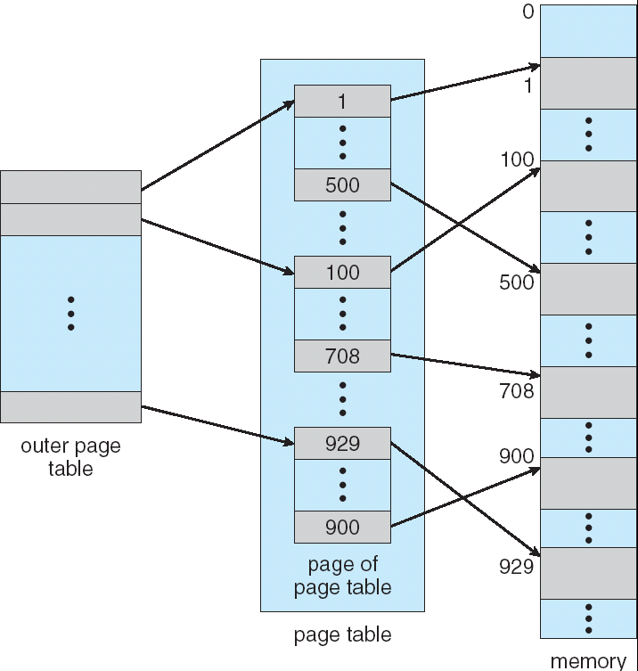
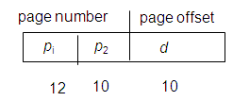
Hierarchical Page Tables
Page the page table
Two or multi-level page table
A logical address (on 32-bit machine with 1K page size) is divided into:
a page number consisting of 22 bits
a page offset consisting of 10 bits
Since the page table is paged, the page number is further divided into:
a 12-bit page number
a 10-bit page offset
Thus, a logical address is as follows:
where pi is an index into the outer page table, and p2 is the displacement within the page of the outer page table

Slide 15
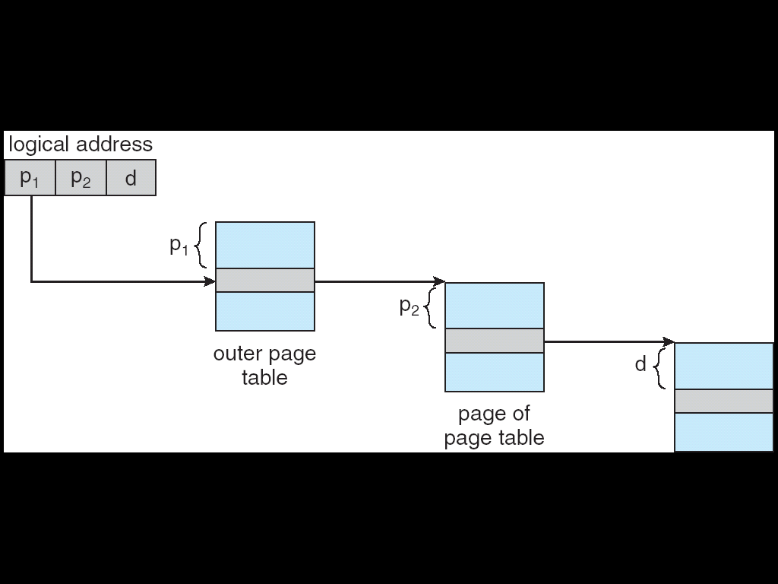
Address-Translation Scheme

Slide 16
Hashed Page Tables
Common in address spaces > 32 bits
Hierarchical paging is too slow (in case of a TLB miss)
The virtual page number is hashed into a page table. This page table contains a chain of elements hashing to the same location.
Know what is a hash table?
Virtual page numbers are compared in this chain searching for a match. If a match is found, the corresponding physical frame is extracted.

Slide 17
Brief Introduction on Hash table
Why hash table?
Suppose that we want to store 10,000 students records (each with a 5-digit ID) in a given container.
A linked list implementation would take O(n) time.
A height balanced tree would give O(log n) access time.
Using an array of size 100,000 would give O(1) access time but will lead to a lot of space wastage.
Is there some way that we could get O(1) access without wasting a lot of space?
Consider the case of large 64-bit address space with sparse entries (limited by physical memory & hard disk)

Slide 18
Types of Hashing
There are two types of hashing :
1. Static hashing: In static hashing, the hash function maps search-key values to a fixed set of locations.
In case of collision -> add overflow entries
2. Dynamic hashing: In dynamic hashing a hash table can grow to handle more items. The associated hash function must change as the table grows.
In case of collision -> grow the hash table

Slide 19
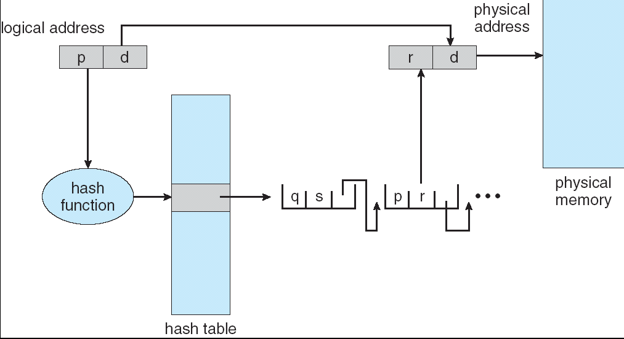
Hashed Page Table

Slide 20
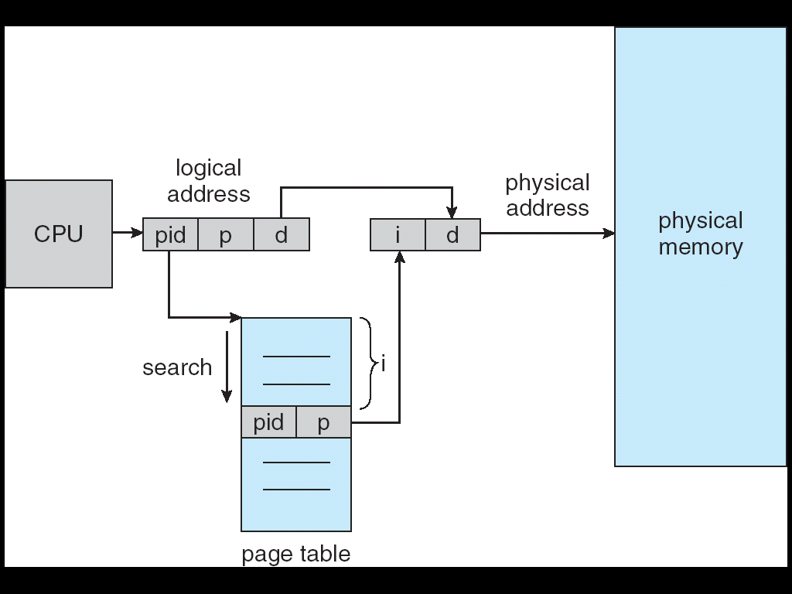
Inverted Page Table
To keep the page table small
One entry for each frame of the physical memory
Each entry has (pid, page-number)
Given (pid, page-number), how to find the physical frame?
Very slow: scan entries in the table
Fast: build a hash table with the hash key = (pid, page-number)

Slide 21
Conclusion
This lecture enables the students to understand Paging, shared pages, implementation of page tables and page table structures.

Slide 22
Video Link
https://www.youtube.com/watch?v=pJ6qrCB8pDw
https://www.youtube.com/watch?v=2pgI46Q72fA
https://www.youtube.com/watch?v=SqYigYLFvcI

Slide 23
References
https://www.geeksforgeeks.org/partition-allocation-methods-in-memory-management/
https://www.javatpoint.com/os-memory-management-introduction
http://www2.latech.edu/~box/os/ch08.pdf
https://www.cs.uic.edu/~jbell/CourseNotes/OperatingSystems/8_MainMemory.html#:~:text=8.3%20Contiguous%20Memory%20Allocation,allocated%20to%20processes%20as%20needed.
http://www.csdl.tamu.edu/~furuta/courses/99a_410/slides/chap08
https://www.tutorialspoint.com/operating_system/os_memory_management.htm
https://www.studytonight.com/operating-system/memory-management
https://www.guru99.com/os-memory-management.html

